Slide 1

Introducing the Ci40 IoT kit
Let’s make IoT real
Platforms for building, scaling and powering the Internet of Things
Sept 2016

Slide 2
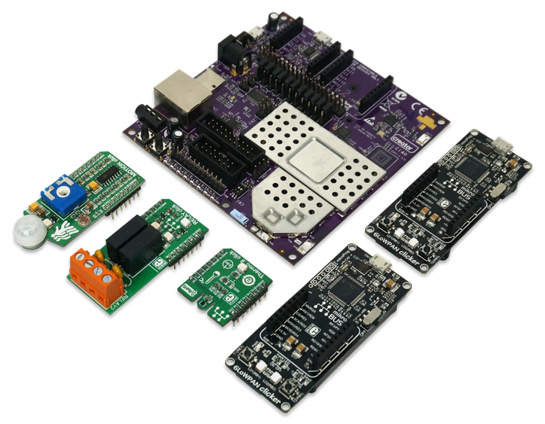

Creator Ci40 IoT-in-a-Box Development Kit Overview
Platform & hub
All the required building blocks to develop a wireless IoT system
Including sensors, wireless protocols, IoT gateway, cloud & open source examples
Technologies
550MHz Dual-core, dual-thread MIPS CPU
Ensigma Wi-Fi 802.11 AC 2x2
BT and BTLE
Cascoda 802.15.4
Ethernet
Cloud connected

Slide 3
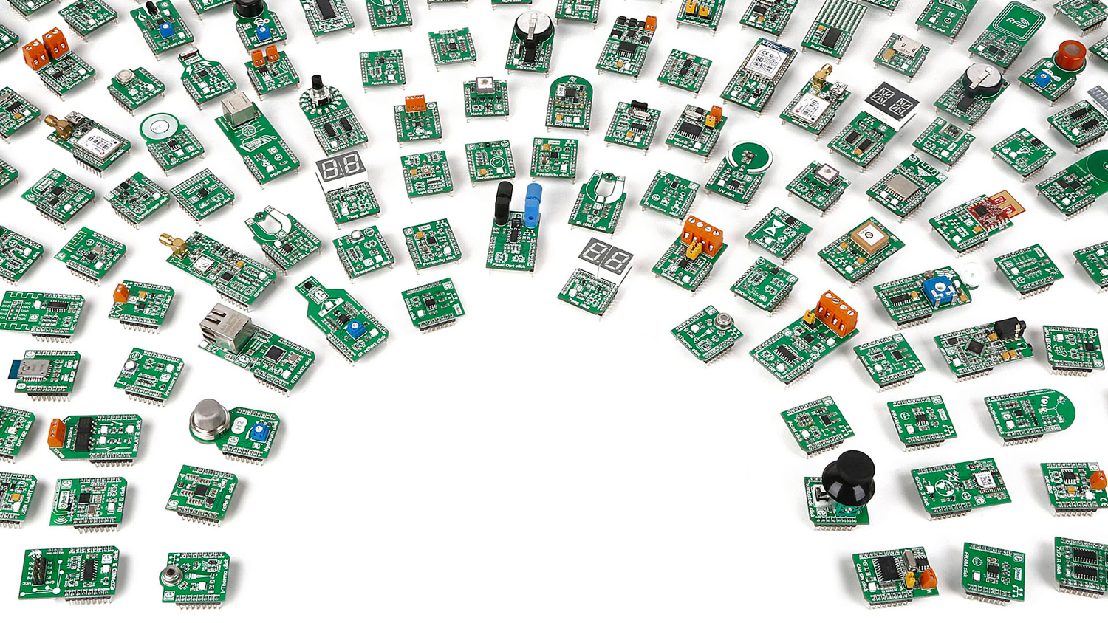

CLICK
BOARDS

Slide 4
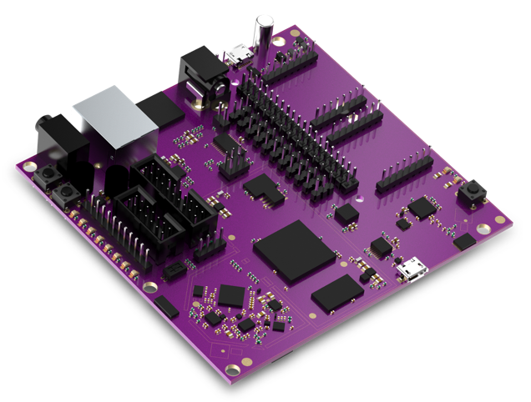
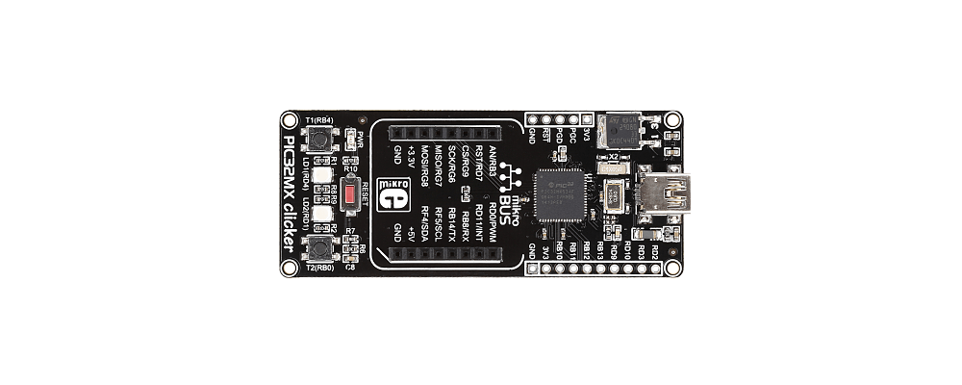

LetMeCreate
Application
Contiki
User Space
LMC API
LMC API
IOCTL
Kernel
I2C
GPIO
SPI
UART
PWM
ADC
I2C
GPIO
SPI
UART
PWM
ADC

Slide 5
160 lines
<
18 lines
<
LMC-ify
<

Slide 6
Application software
All the required building blocks to develop a wireless IoT system
Including sensors, wireless protocols, IoT gateway, cloud & open source examples
IPSO objects
LWM2M
Awa
COAP
DTLS
UDP
SMS
6LoWPAN
3G
LTE
802.15.4

Slide 7






LWM2M server: Creator Device Server
Open source & available today on Github
Open source & standards based device management, a non-proprietary solution for the control plane: one that can be taken and hosted anywhere on public or private cloud
CREATOR DEVICE SERVER
Free hosted example for developers
Hosting & services
Open source repository
Connected devices
Reference designs
REST APIs

Slide 8



10,000 ft view
Open Source Available now
Edge
IoT
Hub
Your cloud app
LMC
Creator Device
Server
REST API
AWA
AWA

Slide 9
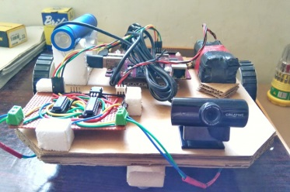
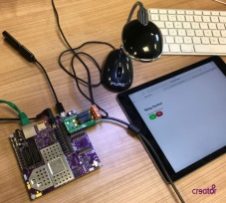
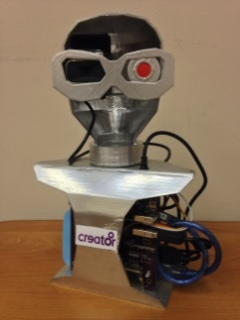

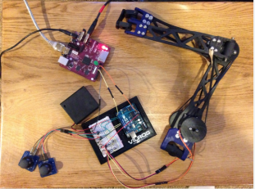
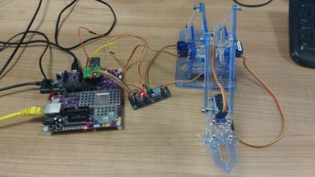
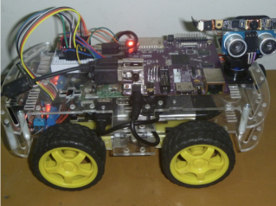
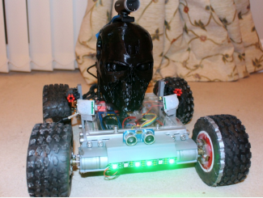
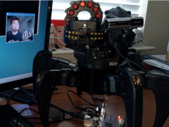

Slide 10
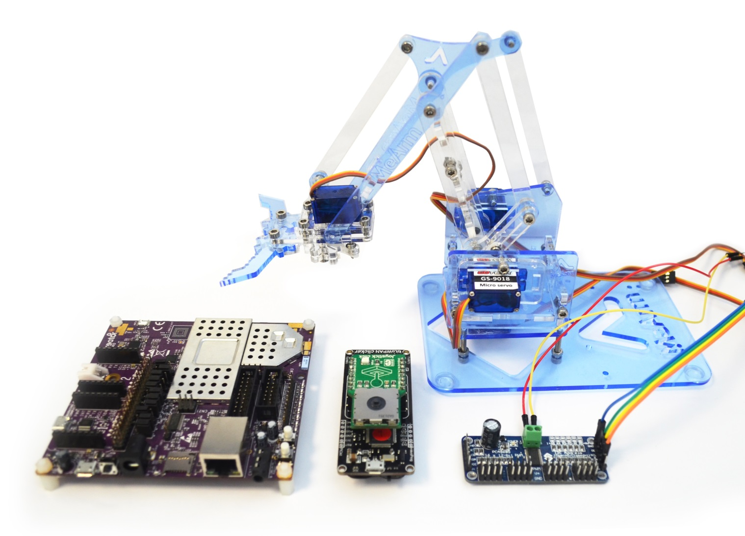

Slide 11



WIRELESS FREEDOM
CHAOS CALMER (15.05, r46767)
½ oz Gin
¼ oz Triple Sec
¾ oz Lime Juice
½ oz Orange Juice
1 tsb. Grenadine Syrup
Shake with a glassful of broken ice and pour unstrained into a gobl
root@openWrt:/#

Slide 12
Standard Divider
Confidential
Notes:
12

